Slide 1
Temperature Monitoring System with Appliance Control
By :
Soumya Goyal (189202020) - ECE
Vaishnavi Agarwal (189202015) - ECE

Slide 2
Introduction
IoT (Internet of Things) is an advanced automation and analytics system which exploits networking, sensing, big data, and artificial intelligence technology to deliver complete systems for a product or service. These systems allow greater transparency, control, and performance when applied to any industry or system. IoT systems have applications across industries through their unique flexibility and ability to be suitable in any environment. They enhance data collection, automation, operations, and much more through smart devices and powerful enabling technology.
The project proposes an efficient implementation for IoT (Internet of Things) used for monitoring and controlling the room temperature via World Wide Web. Home automation system uses the portable devices as a user interface. They can communicate with home automation network through an Internet gateway, by means of low power communication protocols like Zigbee, Wi-Fi etc. This project aims at controlling room temperature via android app using Wi-Fi as communication protocol and Node MCU as server system. NodeMCU is an open source IoT platform.

Slide 3
The user here will move directly with the system through an android based interface over the web, whereas room temperature is remotely controlled through easy user interface. The server will be interfaced with relay hardware circuits that control the device for controlling the temperature. The server communicates with the microcontroller and if the temperature sense by the temperature sensor exceed the limits then the controlling device will be switch ON through the relay.

Slide 4
Motivation
Temperature control refers to the process that is aimed at maintaining the temperature in a given area at certain maximum/minimum level or within a certain range. This process is commonly used in most areas of the world. Recently, globalization and industrialization has further necessitated the need for Temperature Control applications in various daily activities.
Many Homes and Industries among other areas maintain certain sections of operation that must be maintained within a certain temperature for process to work successfully.

Slide 5
During these processes, the temperature needs to be monitored frequently in order to ensure that it doesn’t rise or fall below a value that would accelerate wearing out of the systems. It is also important to monitor the level of temperature at various other places such as morgues, hospitals, aircrafts, living rooms, warehouses etc. to ensure that thermal comfort is maintained.
Temperature controlled fan helps elderly and disabled people to monitor speed of fan from wherever they are instead of manually controlling it.
The major objective of this project would be to create a Temperature Control System that would be able to automatically control the temperature of the environment it is placed in by the timely activation of the effector devices to influence the temperature in relation to the set-point.

Slide 6
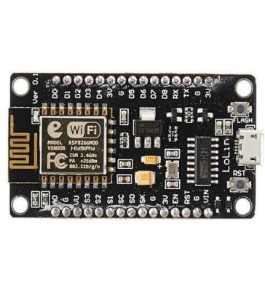
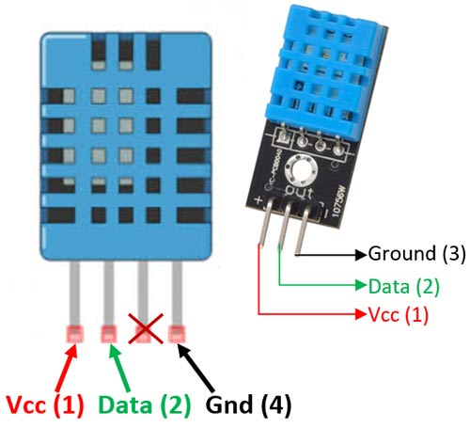
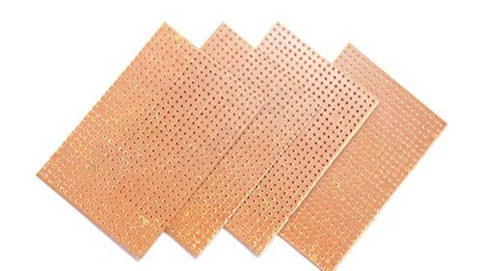
Hardware Elements
NodeMCU: It is an open-source Lua based firmware & development board specially targeted for IoT based applications. It includes firmware that runs on the ESP8266 Wi-Fi SoC & hardware which is based on the ESP-12 module.
DHT 11: It is a commonly used temperature & humidity sensor. The sensor can measure temperature from 0°C to 50°C and humidity from 20% to 90% with an accuracy of ±1°C and ±1%. So if you are looking to measure in this range then this sensor might be the right choice for you.
General Purpose PCB: Used to embed circuits randomly for running of hardware. Its layer is coated with copper and allows proper soldering without any short circuit.

Slide 7
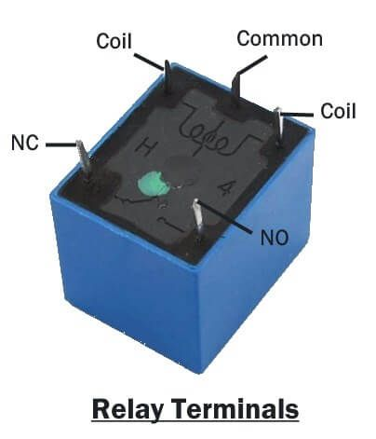
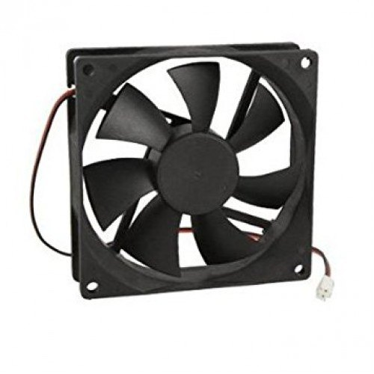
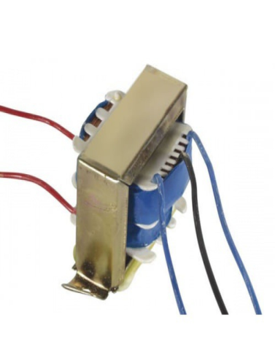
Relay: It is a switch which controls (open and close) circuits electromechanically. The main operation of this device is to make or break contact with the help of a signal without any human involvement in order to switch it ON or OFF. It is mainly used to control a high powered circuit using a low power signal. Generally a DC signal is used to control circuit which is driven by high voltage like controlling AC home appliances with DC signals from microcontrollers.
Fan: The DC fans, are powered with a potential of fixed value such as the voltage of a battery. Typical voltage values for DC fans is 12V.
Transformer: It is a static electrical machine which transfers AC electrical power from one circuit to the other circuit at the constant frequency, but the voltage level can be altered that means voltage can be increased or decreased according to the requirement.

Slide 8
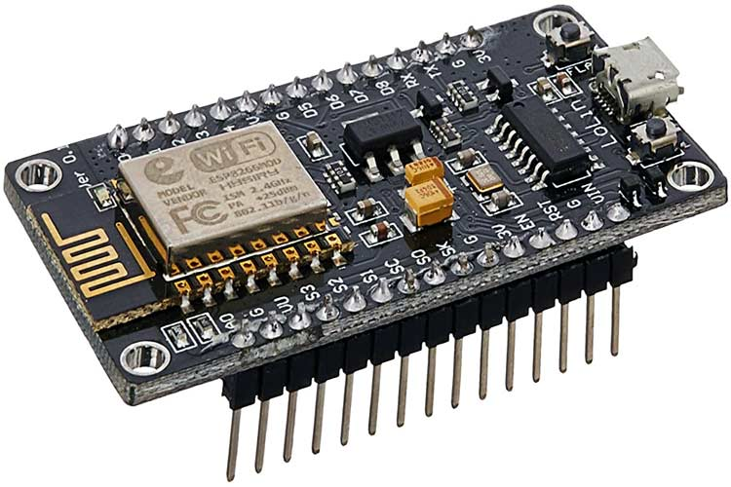
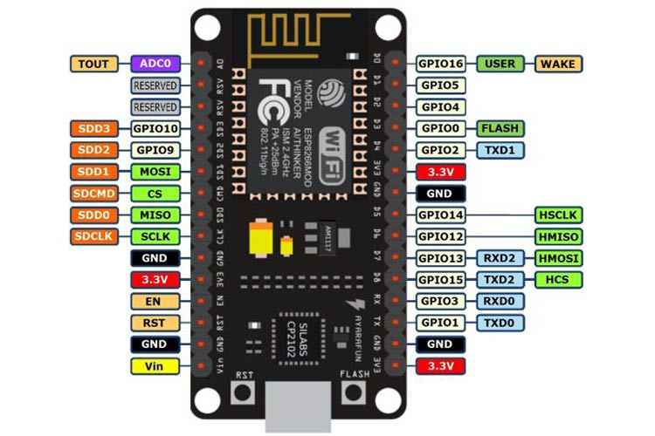

Slide 9
Software Required
BLYNK was designed for the IoT. It can control hardware remotely, it can display sensor data, it can store data, vizualize it and do many other cool things.
Three major components in the platform:
Blynk App - allows to you create amazing interfaces for your projects using various widgets we provide.
Blynk Server - responsible for all the communications between the smartphone and hardware. You can use our Blynk Cloud or run your private Blynk server locally. It’s open-source, could easily handle thousands of devices and can even be launched on a Raspberry Pi.
Blynk Libraries - for all the popular hardware platforms - enable communication with the server and process all the incoming and outcoming commands.
Every time you press a Button in the Blynk app, the message travels to space the Blynk Cloud, where it magically finds its way to your hardware. It works the same in the opposite direction and everything happens in a blynk of an eye.

Slide 10
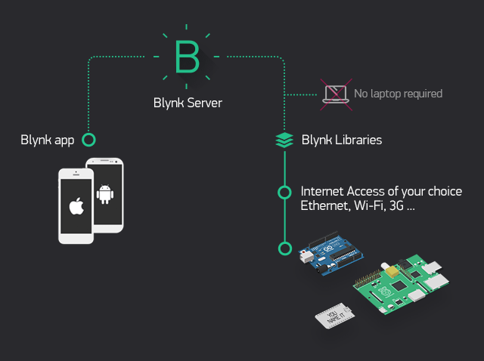

Slide 11
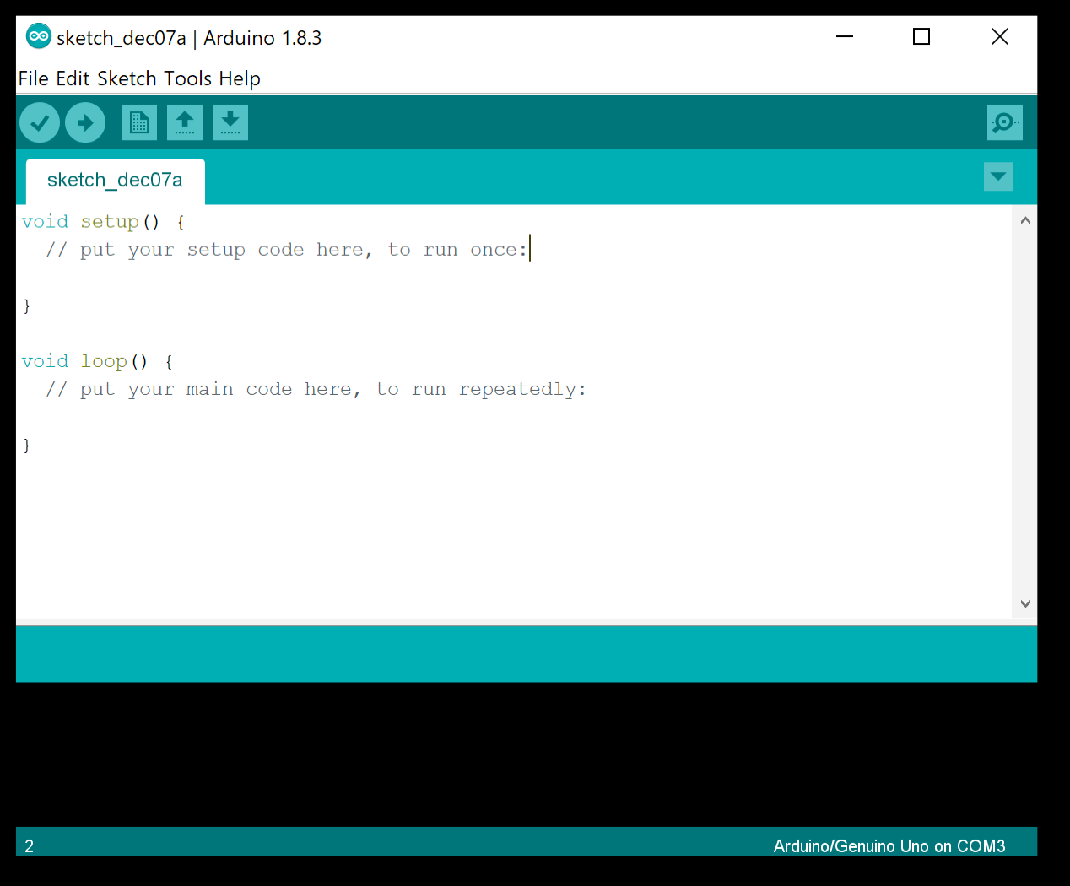
Arduino IDE: The open-source Arduino Software (IDE) makes it easy to write code and upload it to the board. This software can be used with any Arduino board.

Slide 12
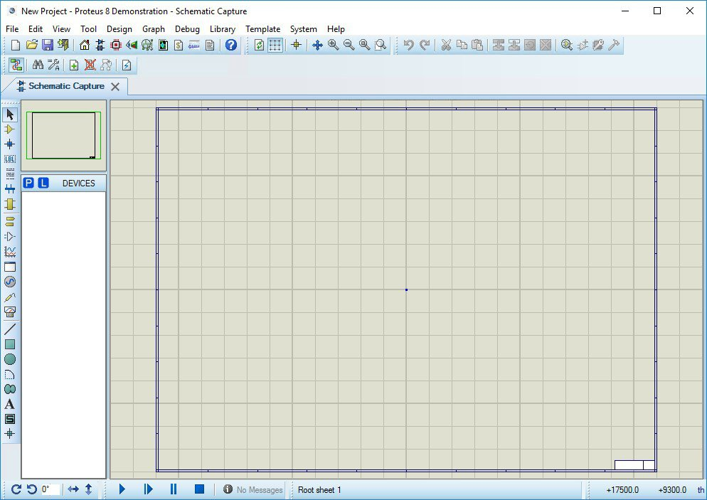
Proteus: It is an electronic circuit design software which includes a schematic capture, simulation and PCB ( Printed Circuit Board) Layout modules.

Slide 13
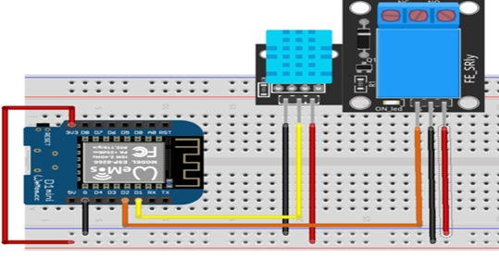
Methodology
Circuit Diagram

Slide 14
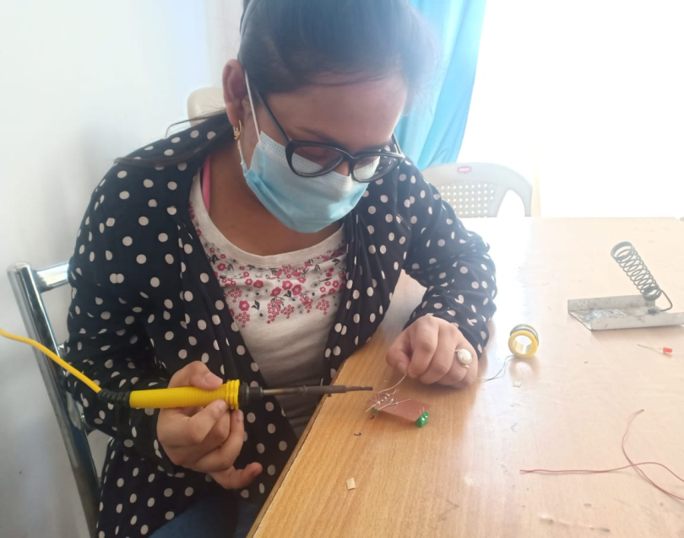
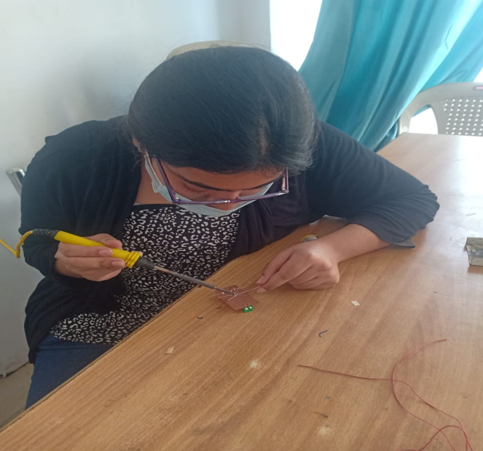
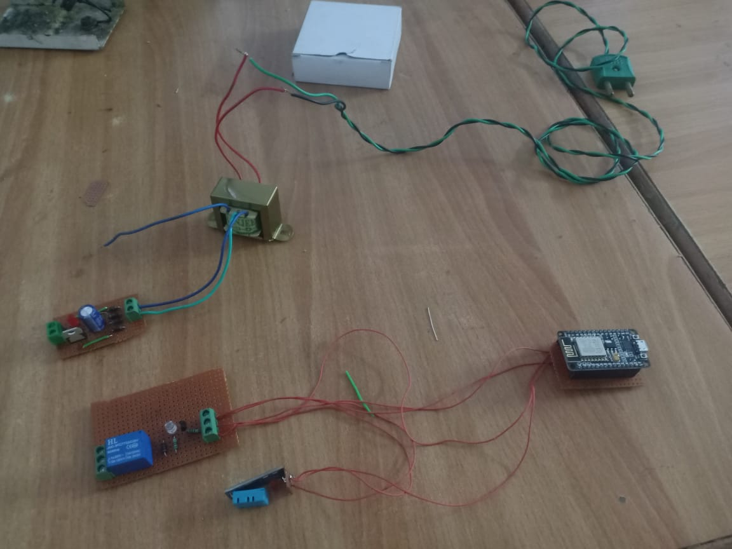
Making

Slide 15
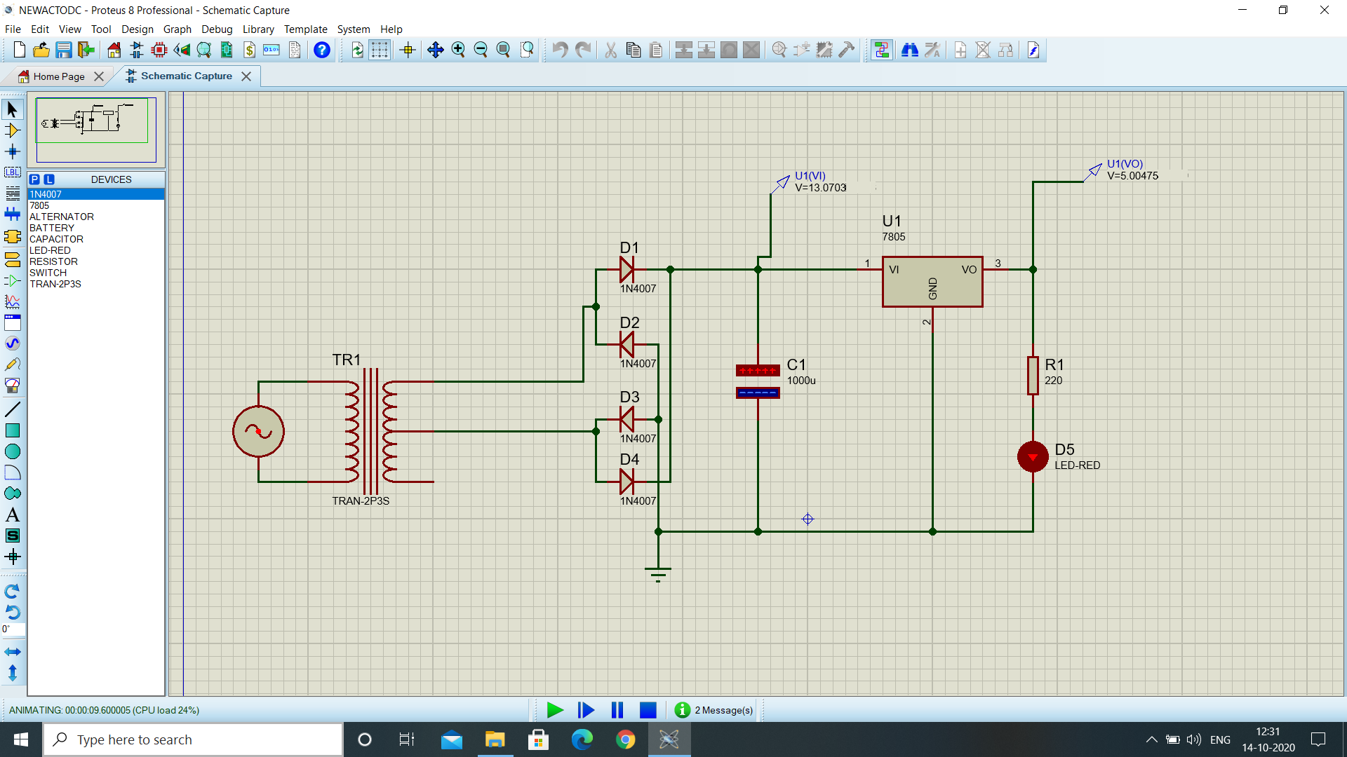
Power Supply

Slide 16
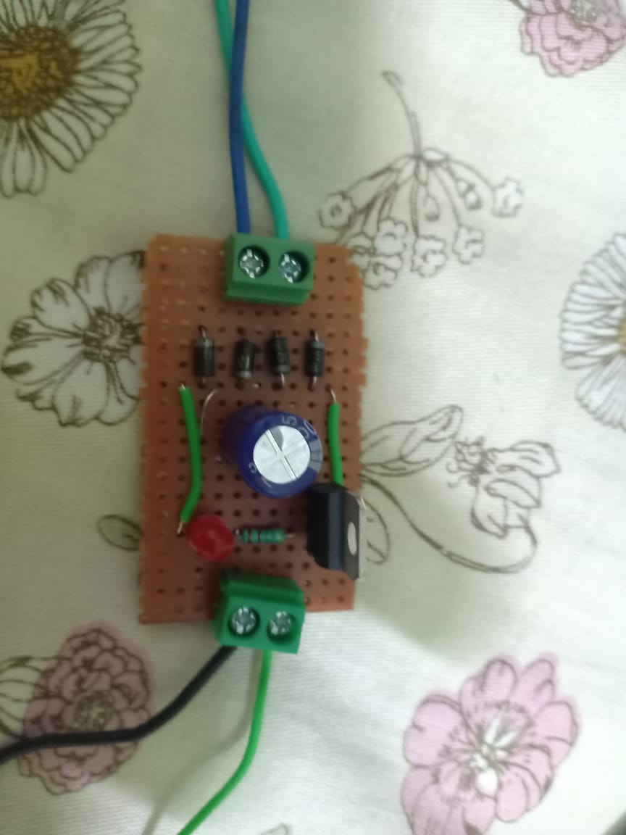
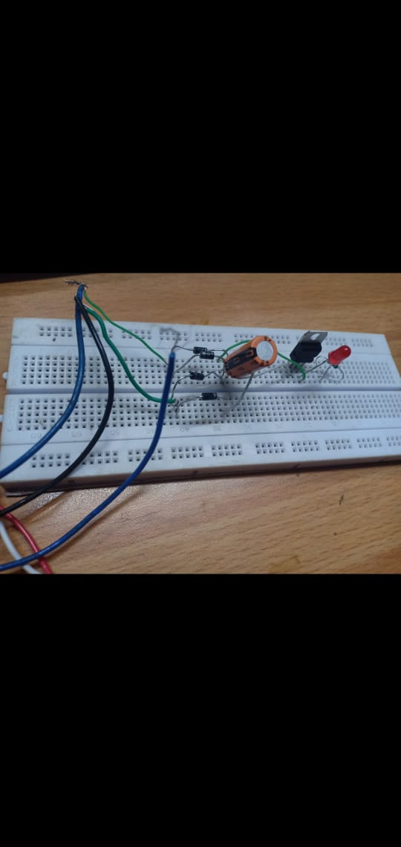

Slide 17
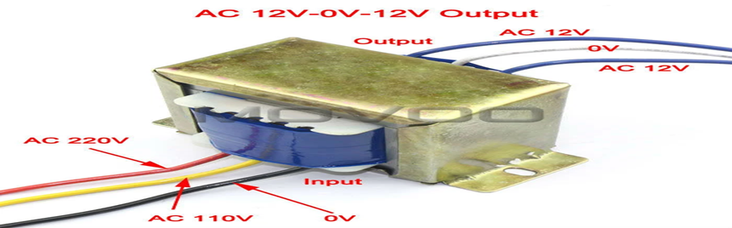
Initially when we want to make small circuits with led which is used to run on batteries .Problem with this battery is that they used to drain soon. The solution to this problem is that we are going to use power supply directly to the ac mains without damaging the circuit.
First we need a step down transformer. As name itself indicates a transformer transform voltages. So step down transformer will transform from higher voltage to smaller voltage, as we need 5V DC supply for Node MCU. So stepping down from 220V to 9V ac using step down transformer.

Slide 18
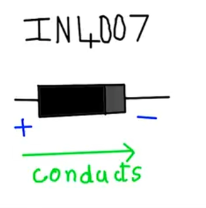
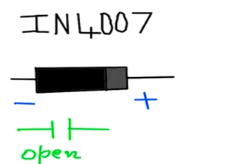
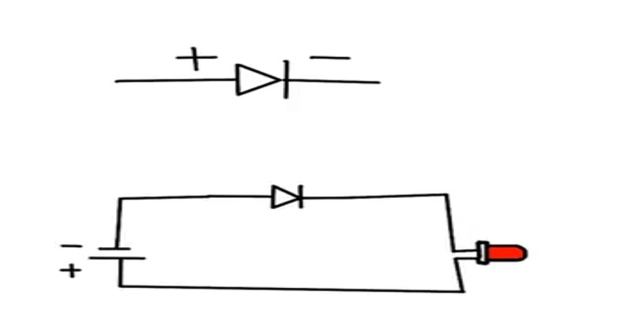
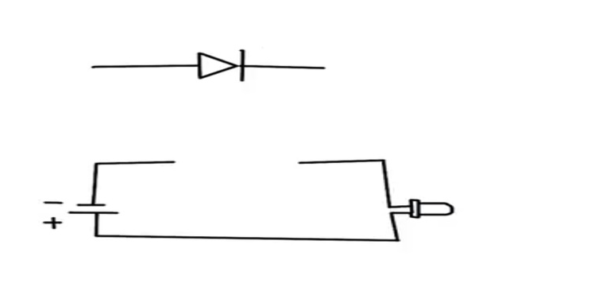
Transformer input and output both are ac voltage. So next step is to convert from ac to dc voltage. To do this we need some diodes. Let’s use a simple IN4007 diode . A diode basically conducts in forward bias condition and act as open source during reverse bias.
My led will not glow, since my diode is reverse biased.
My led will glow in forward bias.

Slide 19

Replacing battery with ac source. Since ac stands for alternating current this is how voltage varies with respect to time.
Now in our case during the time interval of positive half cycle the diode is forward bias, led will glow.
But during negative half cycle diode is reverse bias resulting in an open circuit, turning off led.
So for some duration our led will glow and then it will stop but we don’t want this to happen.

Slide 20
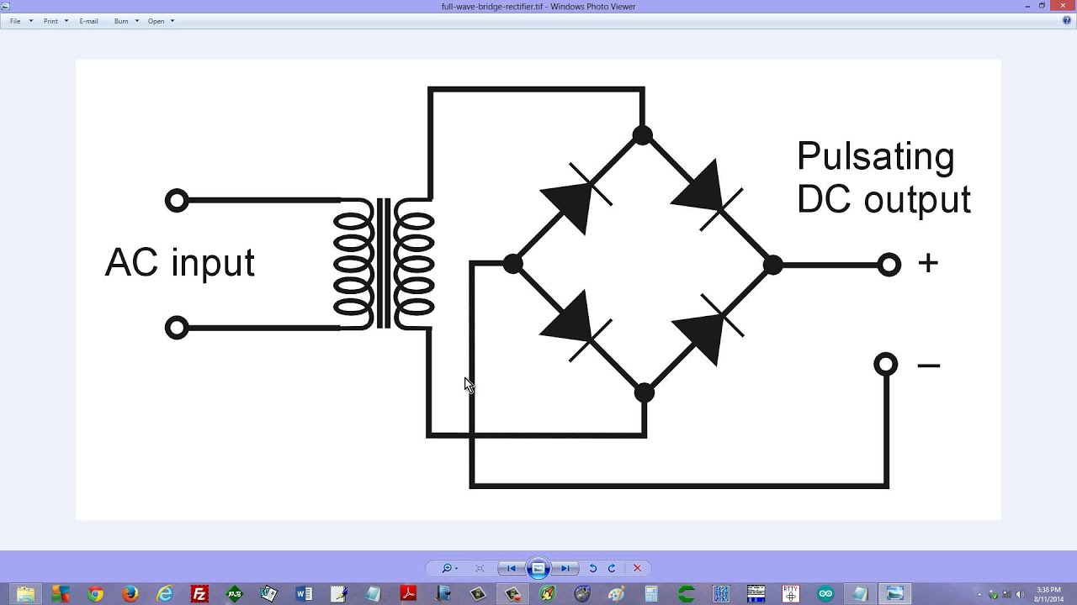
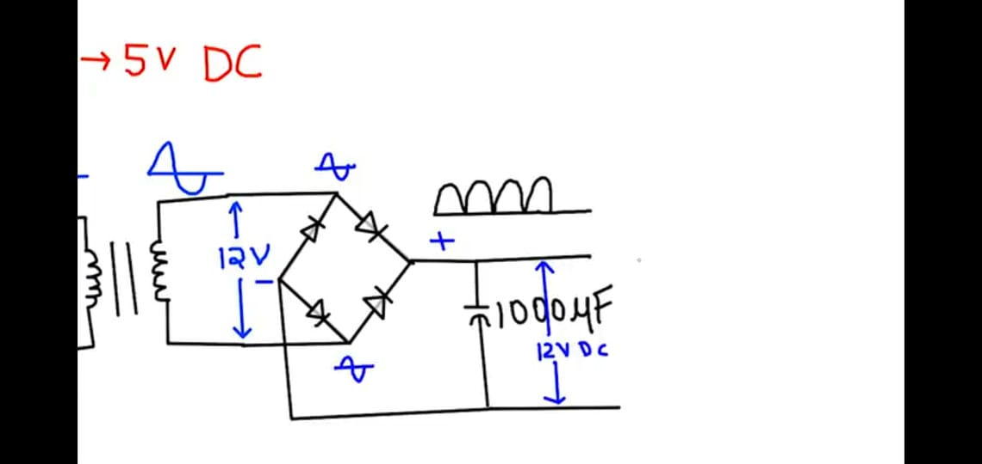
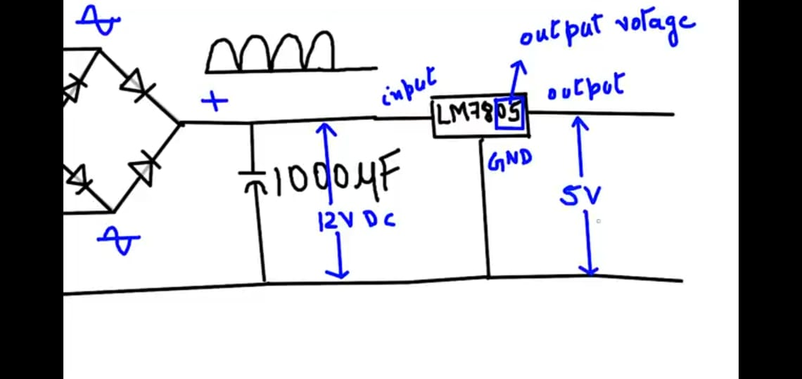
To get an output which has voltage in both positive and negative cycle we need to have 4 diodes. Bridge rectifier consist of four diodes which are connected in the form of a bridge.
The output is still pulsating, to remove this pulsating effect we need to place a filter capacitor parallel to the pulsating output. For frequency of 50hz we can use a capacitor of 1000uf, so now we have proper dc output of 12 V .
Our requirement is 5V for this we need to have a voltage regulator IC, we will use LM7805 regulator IC. So we have a output of +5V output.

Slide 21
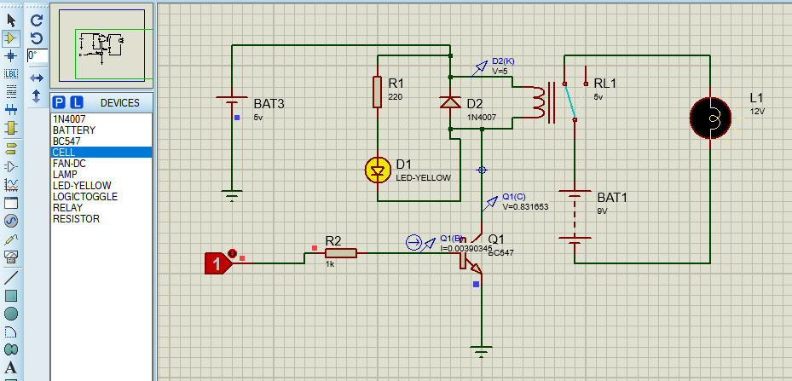
Relay Module

Slide 22
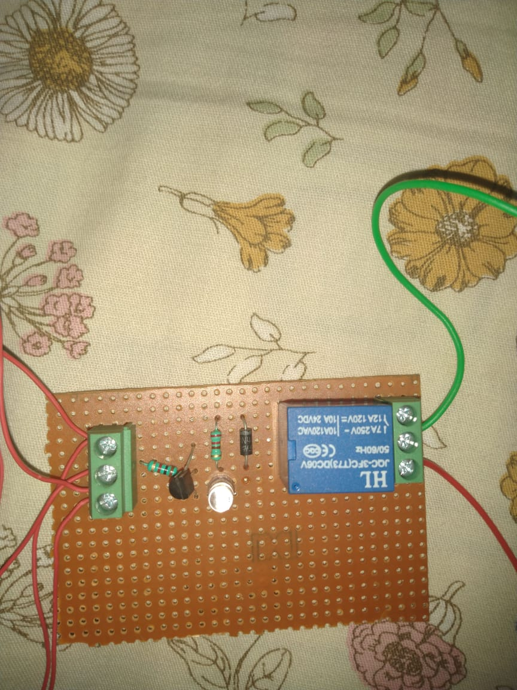

Slide 23
Components Required: diode(1N4007), transistor(BC547), LED, 1kohm resistor, 220ohm resistor, relay, battery, 5V supply, wires.
Advantage of Relays is that it takes a relatively small amount of power to operate the relay coil, but the relay itself can be used to control motors, heaters, lamps or AC circuits which themselves can draw a lot more electrical power.
Bipolar transistors make very good and cheap relay switching circuits, they are current operated devices as they convert a small Base current into a larger load current to energise the relay coil.
From the diagram it can be seen that:
We have given 5V supply to relay.
Parallel to the relay we have connected a 220ohm resistor in series with LED. The purpose of resistor is to limit current through LED & to prevent it from burning. The LED indicates the on status of the relay. That is relay is switching from NC to NO.

Slide 24
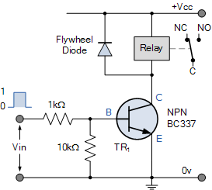
NPN Transistor Relay Driver Circuit
The circuit has the coil driven by a NPN transistor switch, depending on the input voltage level.
When the Base voltage of the transistor is zero (or negative), the transistor is cut-off and acts as an open switch. In this condition no collector current flows and the relay coil is de-energised because being current devices, if no current flows into the base, then no current will flow through the relay coil.
If a large enough positive current is now driven into the Base to saturate the NPN transistor, the current flowing from Base to Emitter (B to E) controls the larger relay coil current flowing through the transistor from the Collector to Emitter.

Slide 25
When power is applied to the coil due to the switching action of the transistor, a maximum current will flow as a result of the DC resistance of the coil. Some of this electrical energy is stored within the relay coil’s magnetic field.
When the transistor switches “OFF”, the current flowing through the relay coil decreases and the magnetic field collapses. However the stored energy within the magnetic field has to go some where and a reverse voltage (back emf) is developed across the coil as it tries to maintain the current in the relay coil. This action produces a high voltage spike across the relays coil that can damage the switching NPN transistor if allowed to build up.
So in order to prevent damage to transistor, a Flywheel Diode (1N4007) also known as a freewheeling diode, is placed with reverse polarity from the power supply & in parallel to the relay’s inductance coil.
This diode makes sure that the reverse EMF generated from the relay coil is shorted through it, and not dumped into the transistor.

Slide 26
Connections
At first we need to establish connection between NodeMCU and DHT11 module and after that we need to create project in BLYNK.
Connections are as follows:
Connect VCC pin of DHT11 module with Vin of NodeMCU.
Connect DATA pin of DHT11 with D1 of NodeMCU.
Connect GND pin of DHT11 with Ground of NodeMCU.
Connect D0 pin of NodeMCU with Relay

Slide 27
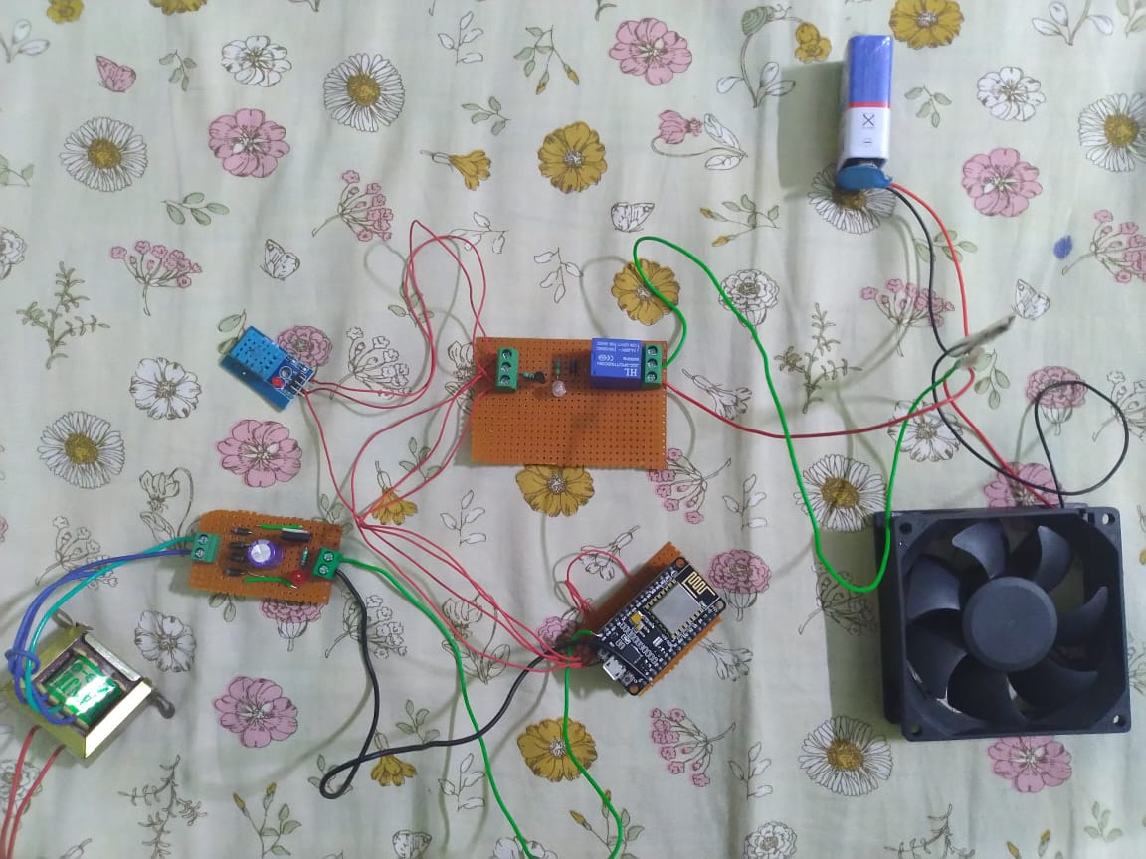
Final Project

Slide 28
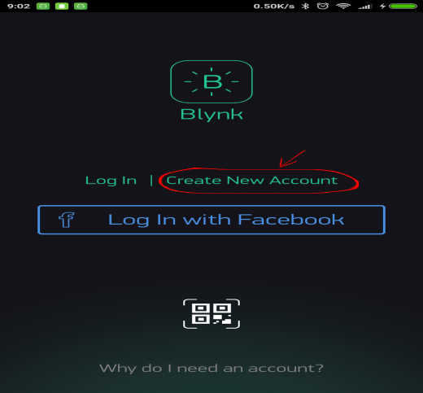

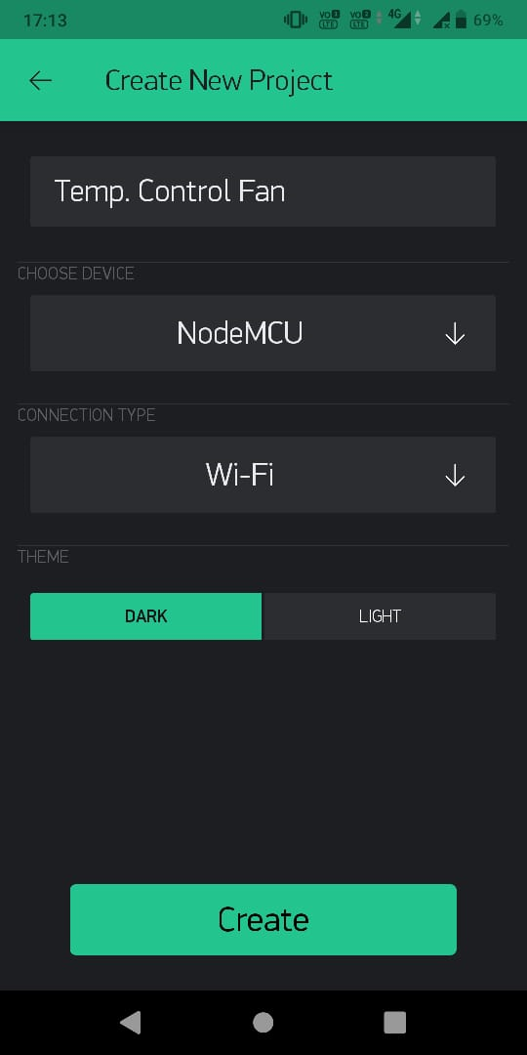
Setup in BLYNK Application
Step1: Create a BLYNK Account
Step3: Write Project Name and Select NodeMCU from dropdown.
Step2: Create a New Project

Slide 29
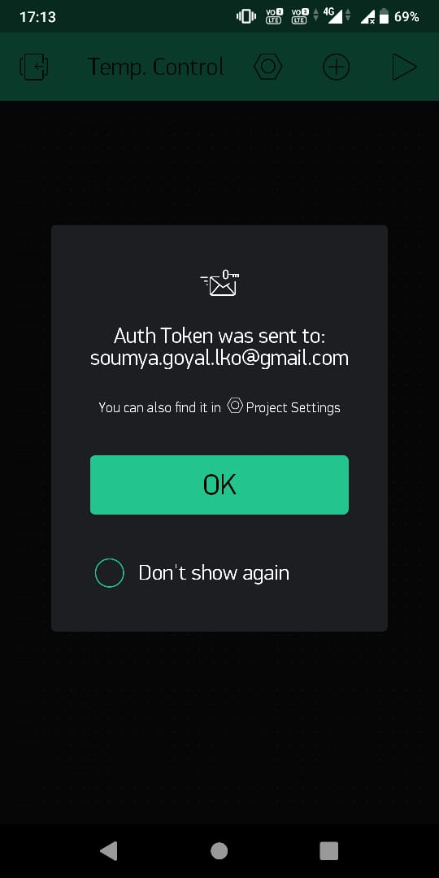
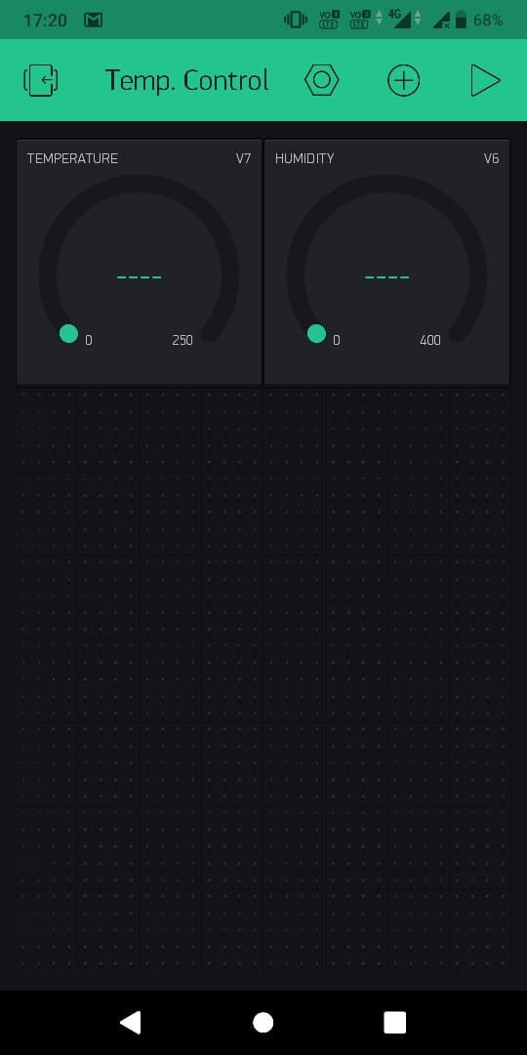
Step4: An AUTH token will be sent to your registered email, note that down.
Step5: Tap on the screen and add a 1Gauges.

Slide 30
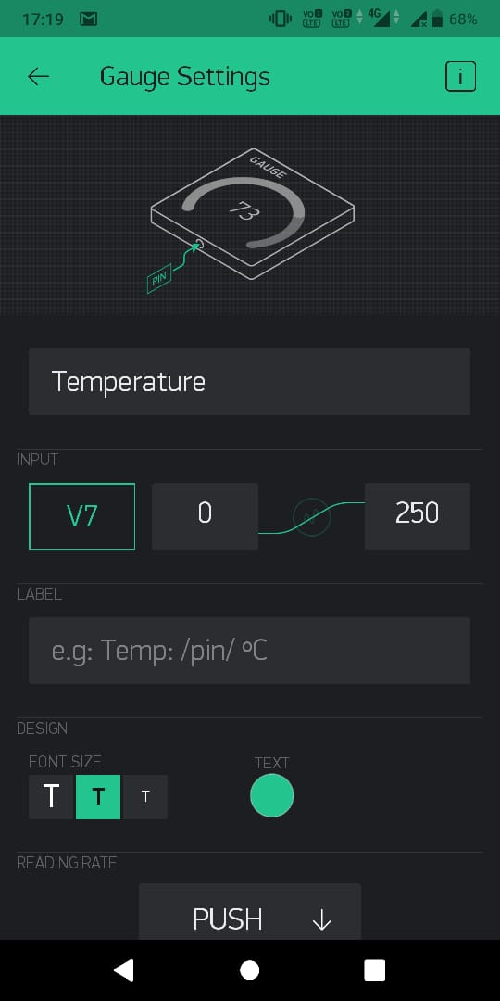
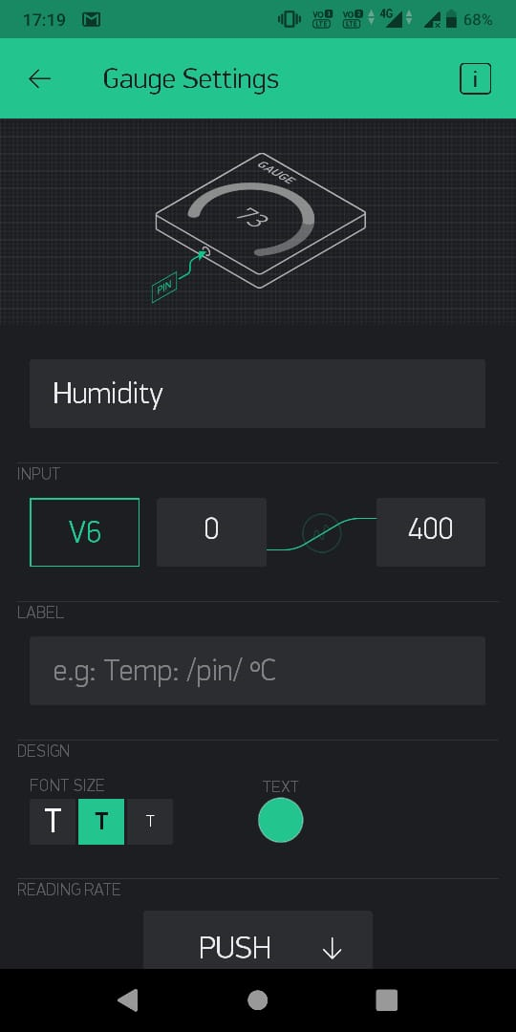
Step6: Tap on the Widget and select the respective Virtual pins for temperature and humidity data (V7 for temperature and V6 for humidity).

Slide 31
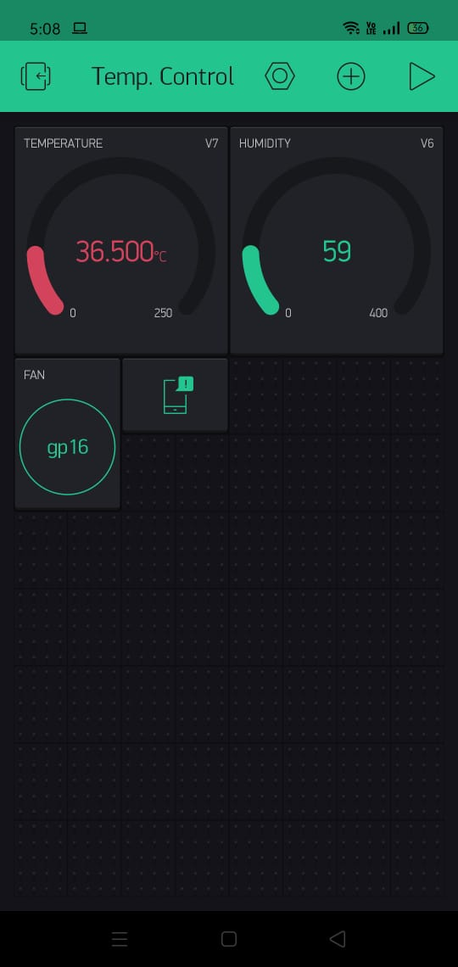
Step6: Tap on screen and add a button for relay
Step7: As temperature and humidity increases above the specified level you will see a notification for it.
By pressing the button the fan will switch on.

Slide 32
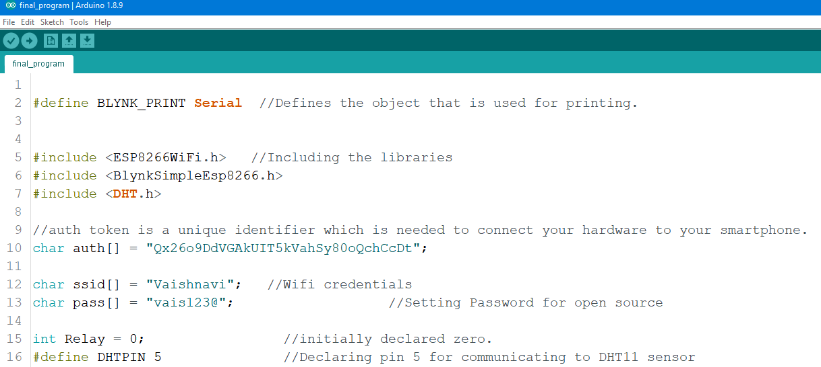
Code

Slide 33
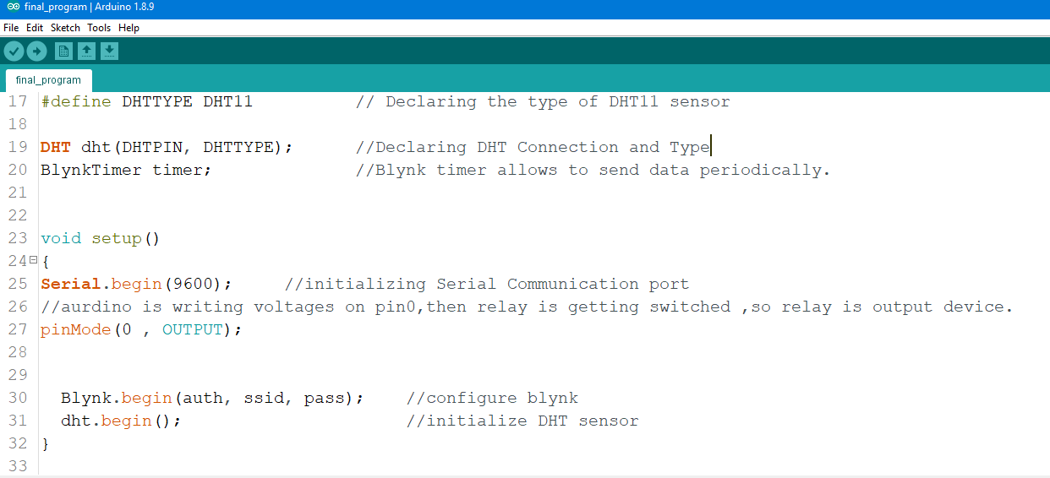

Slide 34
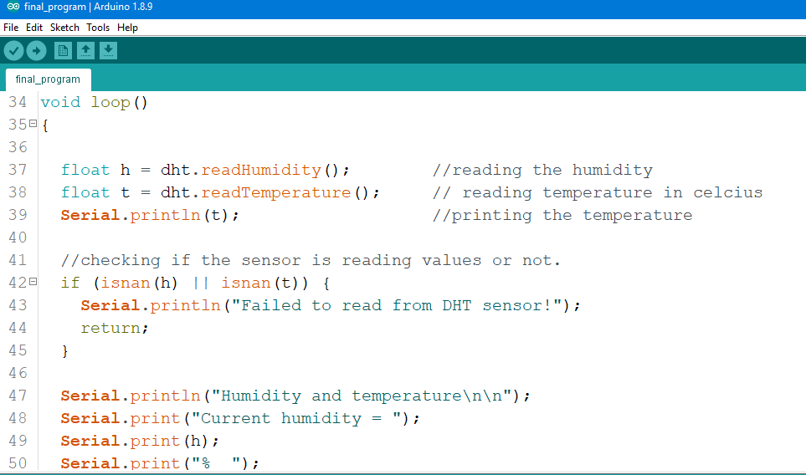

Slide 35
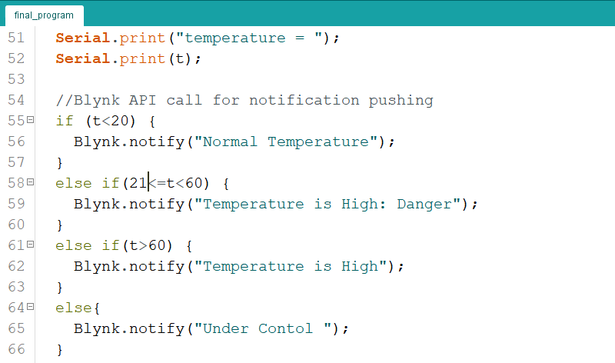

Slide 36
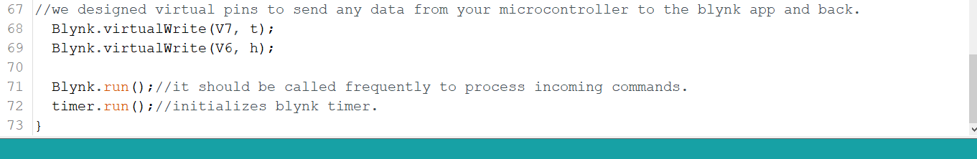

Slide 37
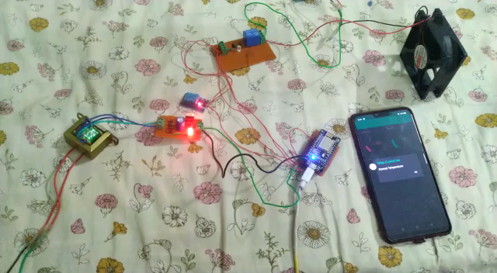
RESULT

Slide 38
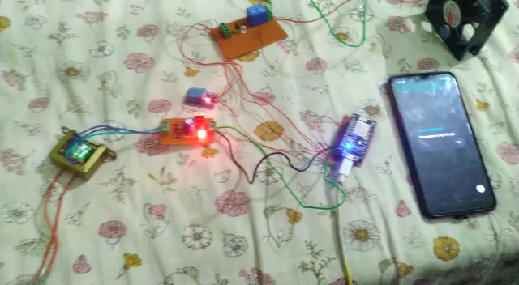

Slide 39
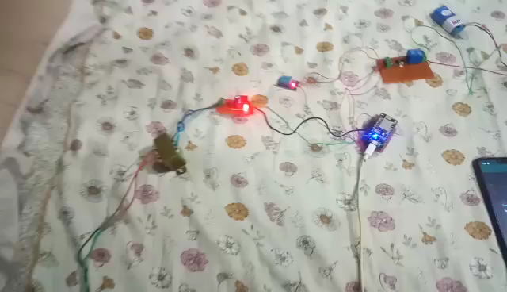

Slide 40
Conclusion
Most human feels the inconvenience about changing the fan speed level manually when the room temperature changes. So, automatic fan system that automatically changes the speed level according to temperature changes is recommended to be built for solving this problem.

Slide 41
References
1.https://www.pantechsolutions.net/iot-based-humidity-and-temperature-monitoring-using-arduino-uno
2.https://hyclassproject.com/overview-of-an-automatic-fan-speed-control-system-using-16f877a-microcontroller.html
3.https://www.who.int/biologicals/expert_committee/Supplement-6-TS-temp-monitoring-ECSPP-ECBS.pdf?ua=1
4. https://docs.blynk.cc/

